Slide 1
COMP1860
Sustainability: What is Sustainability? and
The Circular Economy
Dr. Ruby Hornsby
R.J.Hornsby@leeds.ac.uk
with thanks to the IDEA Centre

Slide 2
Learning Objectives
Critically engage with ideas about what sustainability is
Understand the UN Sustainable Development Goals
Critically engage with the UN Sustainable Development Goals
Apply the concept of sustainability to computer science
Understand the concept of the circular economy
Apply the circular economy to software engineering and hardware development
Critically engage with the circular economy
Content note: Brief mention of sexual violence, miscarriage, sexually transmitted diseases, cancer.

Slide 3
Overview
Defining Sustainability
The UN Sustainable Development Goals
Sustainability and Computer Science: Applications
What is the Circular Economy?
The Circular Economy and Computer Science
Evaluating the Circular Economy

Slide 4
Climate Change
The Scientific Consensus

Slide 5
The Scientific Consensus
Climate change is caused by human activity, most obviously in the form of carbon emissions.
“We analyze the evolution of the scientific consensus on anthropogenic global warming (AGW) in the peer-reviewed scientific literature, examining 11,944 climate abstracts from 1991–2011 […] Among abstracts expressing a position on AGW, 97.1% endorsed the consensus position that humans are causing global warming.”
- John Cook et al.

Slide 6

What could be the likely consequences of anthropogenic climate change if it is not reversed soon?
As a class, think of as many consequences as you can.
Activity:
List

Slide 7
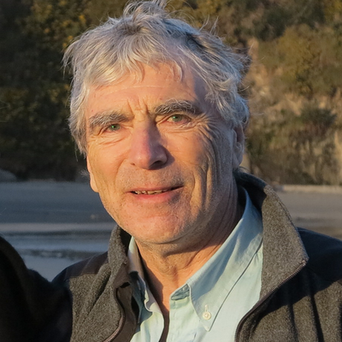
“One thing is sure: if there is extreme warming, the earth will not be able to sustain anything approaching our present population. Our population would have to shrink by millions. We cannot even be confident that humanity will survive at all. Lots of species are already becoming extinct, and we cannot assume ours will not follow them… the collapse or extinction that climate change may cause will be brutal and violent. It will involve killing many people.”
- John Broome
Worst Case Scenario

Slide 8
Defining Sustainability

Slide 9
  One way to mitigate climate change is by living more sustainably!
  What is sustainability? In pairs, come up with a definition.
  Can you think of any problems with this?
Activity 2:
Think, Pair, Share

Slide 10
UN Definition of Sustainability
“Sustainable development is development that meets the needs of the present without compromising the ability of future generations to meet their own needs.”
- UN-Documents.net

Slide 11

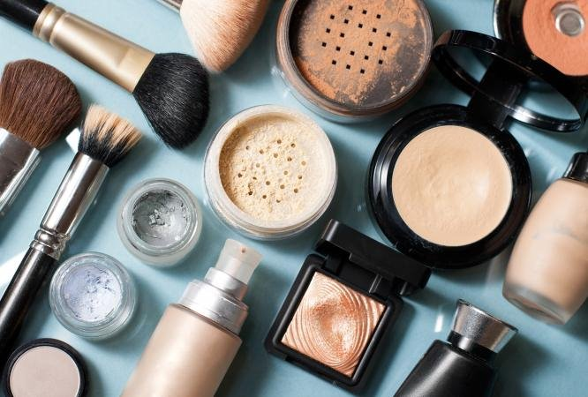
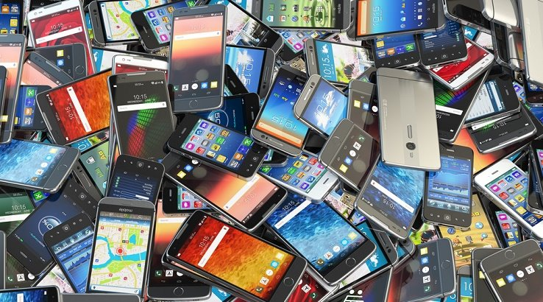


Needs versus Wants
The UN definition makes needs of present and future generations central.
But, what are needs?
Do we need:
  Internet access, mobile phone?​
  Air travel?​
  Meat, cheese?​
  Cosmetics?​
  Fashionable versus practical clothes?

Slide 12
What are Needs?
Grey areas.
  Whether something counts as a want or need is not binary, but more like a sliding scale.
Structural considerations matter.
  Do you need a phone/car? It depends on the surrounding infrastructure.
Social norms matter:
  “A linen shirt is, strictly speaking, not a necessary of life. The Greeks and Romans lived, I suppose, very comfortably though they had no linen. But in the present times, through the greater part of Europe, a creditable day-labourer would be ashamed to appear in public without a linen shirt, the want of which would be supposed to denote that disgraceful degree of poverty which, it is presumed, nobody can well fall into without extreme bad conduct.”
  - Adam Smith, The Wealth of Nations ​
Social needs matter:
  “appearing in public without shame” / being treated as an equal

Slide 13
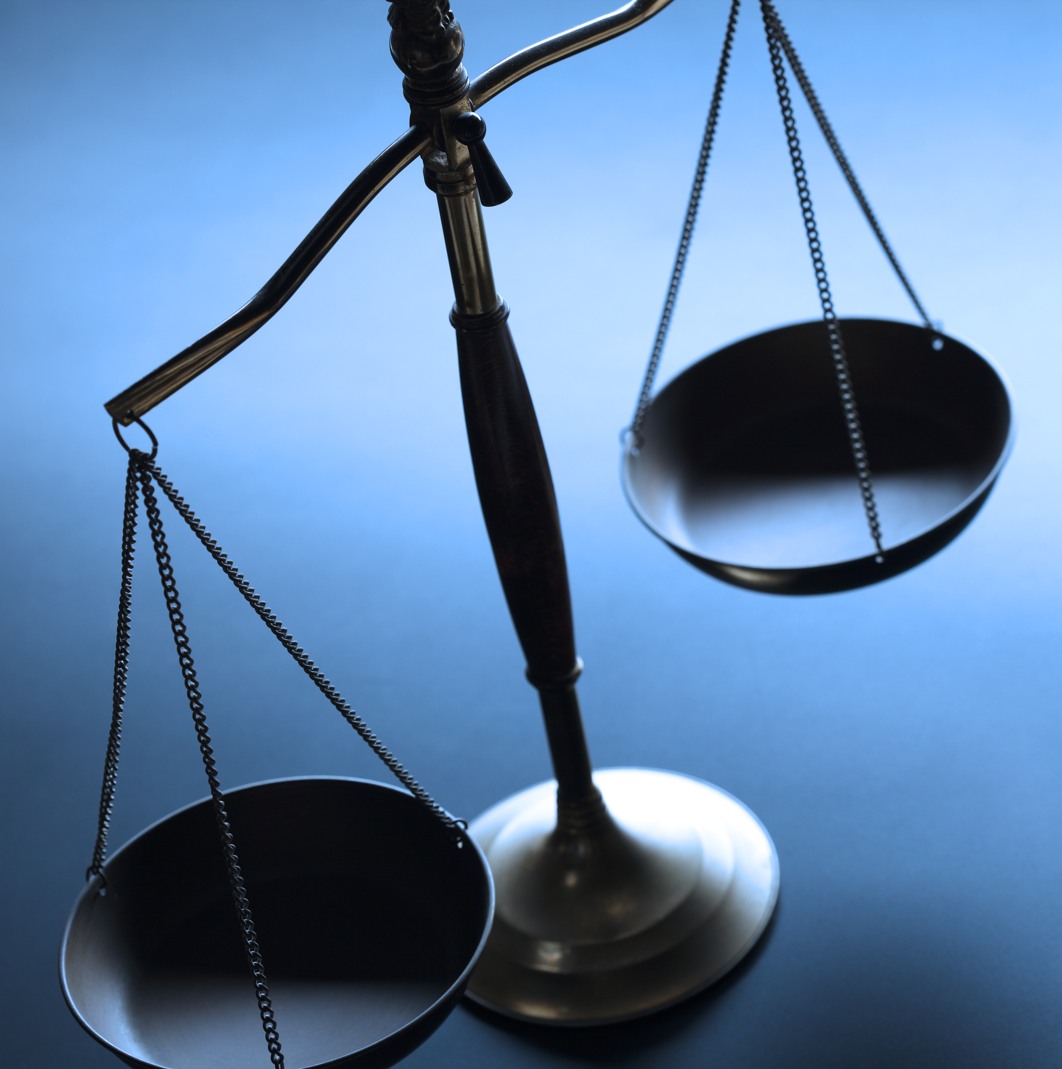
So, it’s unclear what sustainability requires us to maintain for people alive not and for future generations.
Does sustainability require meeting the needs of people alive now, while:
  Ensuring the same standard of living for future generations?
  Ensuring a better standard of living for future generations?
  Ensuring that future generations can meet the basic needs required for survival?
  Ensuring that future generations have enough for a minimally flourishing life (whatever this means)?
Needs versus Wants

Slide 14
UN SDGs
The UN helps us out here by specifying the United Nations Sustainable Development Goals (UN SDGs).
These represent overarching goals to ensure sustainability.
They illustrate an idea of sustainability that goes well beyond reducing carbon emissions and protecting the natural environment.

Slide 15
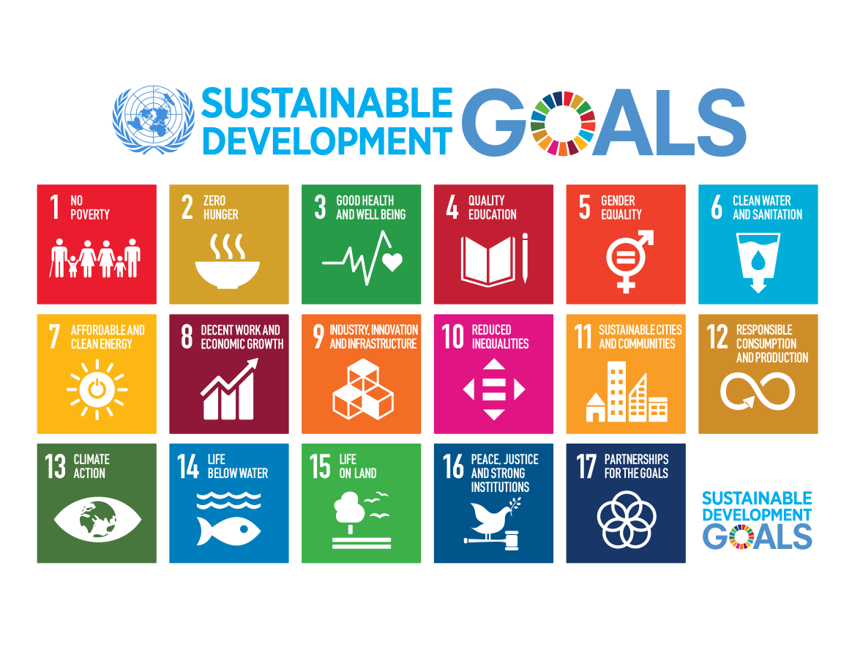
Activity 3: Discussion
Which SDGs are most relevant to your work as computer scientists?
(These might be SDGs that your work supports or SDGs causes problems for.)
Are there any SDGs that are not relevant to your work as computer scientists?

Slide 16
UN SDGs and Engineering
The Risks
What resources are required to build the hardware and run the software you design?
Do your innovations replace human labour with automation?
Does your work have military applications?

Slide 17
UN SDGs and Engineering
Engineering as a Force for Sustainability
Does your work increase efficiency and meet people’s needs?
Does your work reduce carbon emissions and other pollution?
Do you engage in inclusive design and support equity at work?

Slide 18
UN SDGs and Engineering
Implications
Sustainability can be understood much more broadly than reducing carbon emissions.
Computer science can both advance and undermine sustainability.
Most of the ethical issues you will consider during your degree relate to the UN SDGs.

Slide 19
Coal-Powered Data Centres, Mining Rare Earth Elements, and Waste
Some Applications

Slide 20
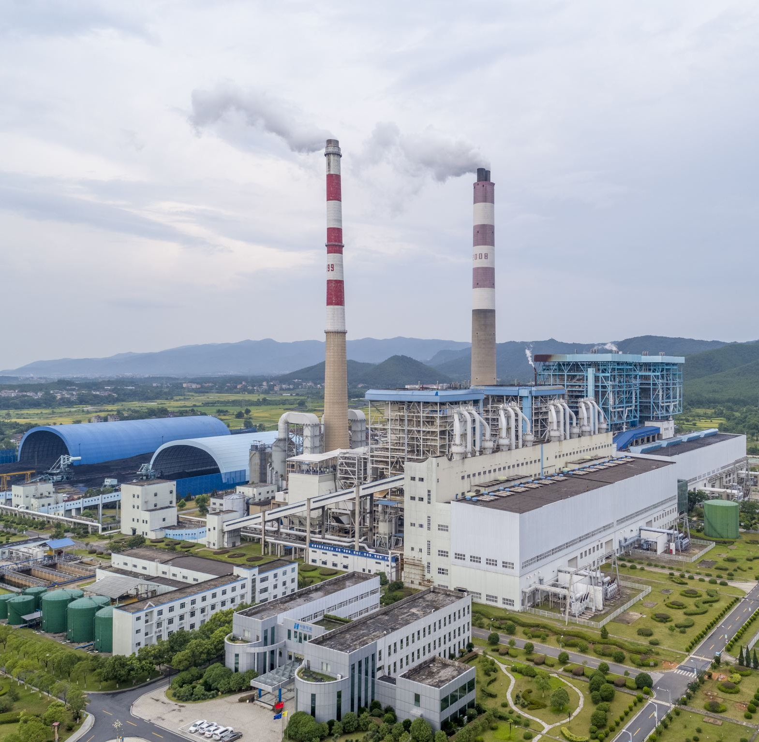
AI is driving a nationwide data center building boom.
Data centers of thousands of computer servers and cooling equipment have multiplied in Northern Virginia since the late 1990s. Currently, 300 data centers in Virginia.
Data Centers bring millions of dollars of revenue to the area in annual taxes.
Data Centres and Coal Power
(Olivo 2024)

Slide 21
They consume massive amounts of energy. One data center can require 50 times the electricity of a typical office building.
“approximately 1.5%...of global electricity demand in 2020” (Alissa et al. 2025: 331).
Predicted that by 2035, the industry in Virginia will require 11,000 megawatts, nearly quadruple what it needed in 2022, or enough to power 8.8 million homes.
Data Centres and Coal Power
(Olivo 2024)

Slide 22
Chris Hamilton, President of the West Virginia Coal Association: “We’re holding on tight to our coal plants.”
Utility companies are building more power lines to meet demand, interfering with people’s property and putting pressure on people to sell their land.
So, there has been public backlash. Local and state officials are reconsidering the data center industry’s benefits.
Data Centres and Coal Power
(Olivo 2024)

Slide 23
AI can make work tasks quicker, increasing efficiency and productivity. This enables goods and services to be provided more cheaply to consumers.
It might also increase economic growth, which can improve quality of life, reduce infant mortality, etc.
Significant tax revenue for the local area / state / country, funding schools, infrastructures, etc.
Jobs!
Benefits

Slide 24
Increased energy consumption, relying on coal, contributes to climate change.
Strain on energy provision in local area.
Air pollution near coal plants.
Laying power lines disrupts local residents.
Local residents may be displaced.
Noise pollution from construction.
Unfairness: Coal power supplies data centres in a neighbouring state with clean energy.
Drawbacks
(Olivo 2024)

Slide 25
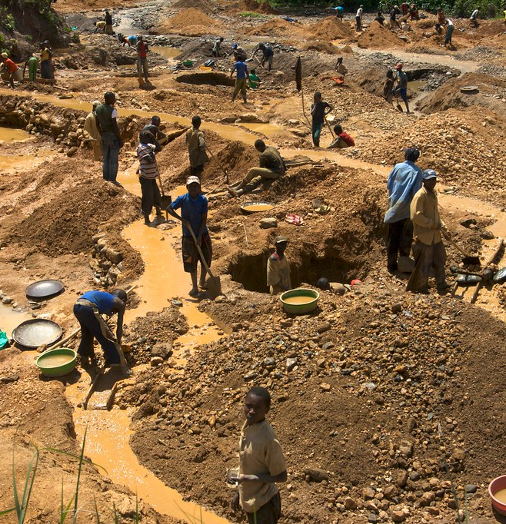
Computer technology relies on rare earth elements (REE).
Supply lines are insecure, as mining often takes place in areas affected by conflict, e.g. Russia’s invasion of Ukraine (Gill 2022).
Mining causes pollution and comes with social and political implications that harm workers and local communities.
Mining
This Photo by Unknown Author is licensed under CC BY-NC-ND

Slide 26
Mining: Workers
(Wang et al. 2024: 2-5)
Prolonged exposure to REEs (i.e. in mining), results in a range of health conditions.
Respiratory: Inflammation, pulmonary fibrosis, cancer.
Neurological: “motor and sensory impairments, neurodegeneration, neurosis”.
Cardiovascular: Lymphoma and leukaemia.
Reproductive: Miscarriage, “reduced sperm quality,...testicular tissue damage”.
Foetal Exposure: “reduced intelligence and motor ability in children”, increased probability of anaemia.
Other: Reduced bone density and osteoporosis, liver injury, oral cancer (U-shaped relationship), “thyroid disfunction”, “immune system impairment”.

Slide 27
High rates of sexual and other physical violence against women and girls, sexual harassment, HIV/AIDS, reproductive health conditions, and miscarriages amongst those working in mines in Democratic Republic of the Congo.
Mining: Workers
(Mensah and Wynsberghe Forthcoming)
This Photo by Unknown Author is licensed under CC BY-NC-ND

Slide 28
The Chinese government acknowledges the existence of “Cancer villages”: Mining-based pollution causing cancer in locals near mines (Nayar 2021).
Processing ore can pollute groundwater with carcinogenic toxic waste and surroundings with radiation (Dauvergne 2022: 710).
Loss of clean groundwater particularly affects fishing and agriculture, increasing poverty (Mensah and Wynsberghe Forthcoming).
Mining:
Local Communities
This Photo by Unknown Author is licensed under CC BY-NC-ND

Slide 29
Downstream Consequences
Computer technology, recently AI in particular, is also used to assist unsustainable activity.
2019 announcement that ExxonMobil would use Microsoft’s Azure, which includes AI for “performance analysis” to increase oil production by “50,000 oil-equivalent barrels per day” (Coleman 2023).
AI used to identify new oil reserves, enhance efficiency of extraction (Dauvergne 2022: 705-705).
Targeted, automated advertising increases demand and consumption (Dauvergne 2022: 708-709), e.g. in fast fashion (Coleman 2023).

Slide 30
Waste Disposal
Finally, when the technology is disposed of after use, the waste (e-waste) is harmful.
Estimated 74m tons e-waste per year by 2030 (Gill 2022b; Kerwin et al. 2022).
Discarded and hoarded by consumers (Gill 2022a; Gill 202b).
Less than 25% is recycled (Sandhu 2022).
E-waste could be worth $62.5b (Meloni 2019: 68).

Slide 31
Harms of E-Waste Disposal
(Kutscher 2020)
The impact of throwing away your old laptop or phone…
Pollutes water, air, soil, plants, and enters food sources.
Ingesting heavy metals harms nervous, urinary, and cardiovascular systems.
Linked to blood, liver, kidney, learning, and neurological disorders, and cancer.
Linked to reproductive disorders, infertility, miscarriages, and developmental disorders in foetuses and children.

Slide 32
  What can computer scientists do in response to these environmental problems?
  Coal power and data centres.
  Mining REEs and health risks.
  E-Waste.
Activity 4:
Discussion

Slide 33
Computer Science and The Circular Economy

Slide 34
The Importance of Sustainability in Computing
We’ve already seen the importance of sustainability in computing:
  Data centres impose costs, so we should use them efficiently.
  Mining rare earth elements imposes harms, so we should use them efficiently and/or investigate alternatives.
  Waste, particularly e-waste.
One approach to sustainability, and avoiding these harms, is to adopt a circular economy.

Slide 35
The Circular Economy
(Ellen MacArthur Foundation)
“The circular economy is a system where materials never become waste and nature is regenerated. In a circular economy, products and materials are kept in circulation through processes like maintenance, reuse, refurbishment, remanufacture, recycling, and composting. The circular economy tackles climate change and other global challenges, like biodiversity loss, waste, and pollution, by decoupling economic activity from the consumption of finite resources.”
Consumption of finite resources is limited (reduced to close to zero) because finite resources used in products are made to last as long as possible.
Hence, economic activity can continue without ongoing consumption of finite resources.

Slide 36
The Circular Economy: Three Principles
(Ellen MacArthur Foundation)
Eliminate Waste and Pollution
  We need to consider waste and pollution as design flaws rather than inevitable by-products of the things we make.
Circulate Products and Materials
  We can design products to be reused, repaired, or remanufactured. But making things last forever isn’t the only solution. When it comes to products like packaging, we should be able to keep them in circulation, so they don’t end up in landfill.
Regenerate Nature
  There’s no concept of waste in nature. Everything is food for something else. By returning nutrients to the soil and other systems, we can enhance natural resources.

Slide 37
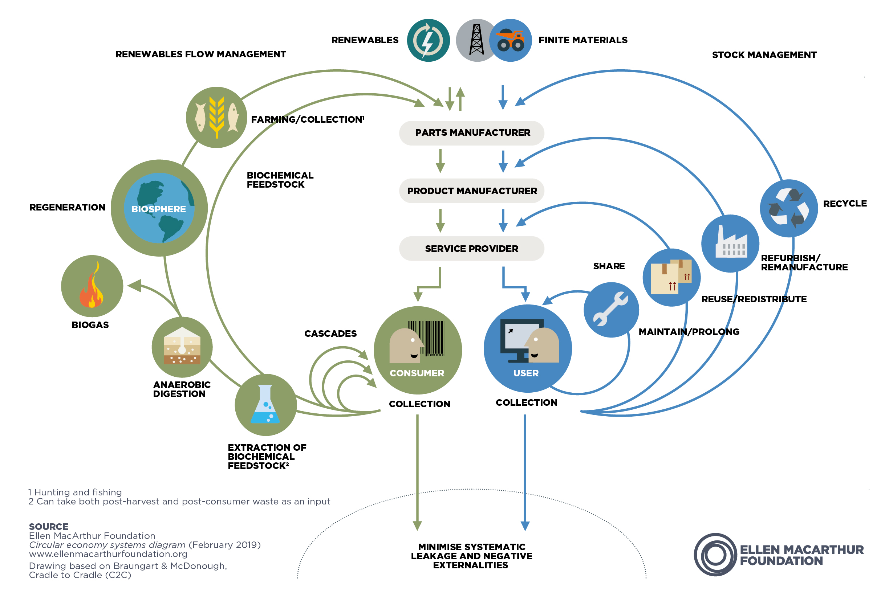
The Butterfly Diagram (Ellen MacArthur Foundation)

Slide 38
Biological cycle (green) includes materials that biodegrade (e.g. food, human and animal waste, cotton, wood).
  Should aim to keep this biodegradable and return this to natural ecosystems safely after use.
Technical cycle (blue) includes materials that will not biodegrade.
  Recycle, refurbish, reuse, maintain, share to increase life of these materials.
Avoid combining these so that they can be recovered.
The Butterfly Diagram
(Ellen MacArthur Foundation)

Slide 39
Inner circles are first responses, outer circles are last resorts.
This aims to reduce energy and material consumption, retain value.
Recycling is last resort because the value of many things is not primarily in the raw materials (e.g. a phone), and this uses more energy than various methods of maintenance.
Remanufacturing an engine massively reduces energy and materials required compared to a new engine, but better still to predict when an engine might break so that it can be maintained instead.
The Technical Cycle
(Ellen MacArthur Foundation)

Slide 40
Repairing and maintaining are better.
These prolong the object, with both the materials and energy used to produce it.
Sharing is best, enables using something for longer with minimal additional energy.
We might add Reducing; manufacturing something with less energy and resources in the first place.
The Technical Cycle
(Ellen MacArthur Foundation)

Slide 41
Social as well as technical solutions.
Can we consume less and more efficiently by sharing?
Currently, cars often serve one or two people and sit idle most of the time.
Would need fewer cars if, e.g. people paid per mile.
  Manufacturers would have incentive to make cars last longer and make materials recoverable, as leasing rather than selling them.
Better to share things that we don’t use often, e.g. share high-quality drill rather than everyone having exclusively owning a low-quality drill.
The Butterfly Diagram
(Ellen MacArthur Foundation)

Slide 42
Applications in Computer Science

Slide 43
  How could computer scientists and technology companies contribute to a circular economy? Think about both hardware and software development.
  Reduce
  Share
  Maintain
  Reuse / Redistribute
  Refurbish / Remanufacture
  Recycle
Activity 6:
Discussion

Slide 44
Reduce, Share, Reuse in Software
(Future Platforms 2025)
“Think of a physical circular economy, where materials are reused and recycled to minimise waste and maximise value. A digital circular economy applies the same logic to your digital assets. Instead of building every new application or feature from scratch (the linear model), you create a system where code, data, infrastructure, and design components are treated as valuable, reusable assets.”
Requires code to be modular, documented, and easily (re)usable by others.
Requires central platform to host code, with explanation of what is there.
Efficient AI develops models for accurate answers with fewer calculations (Lee et al. 2025: 4).

Slide 45
Reduce, Share, Reuse in Software
(Radersma 2022)
Where possible, use a ‘green programming language’, as some use less energy than others.
  One view: C and C++ use less energy than Python.
Recalculating can use less energy than retrieving a previous calculation from storage.

Slide 46
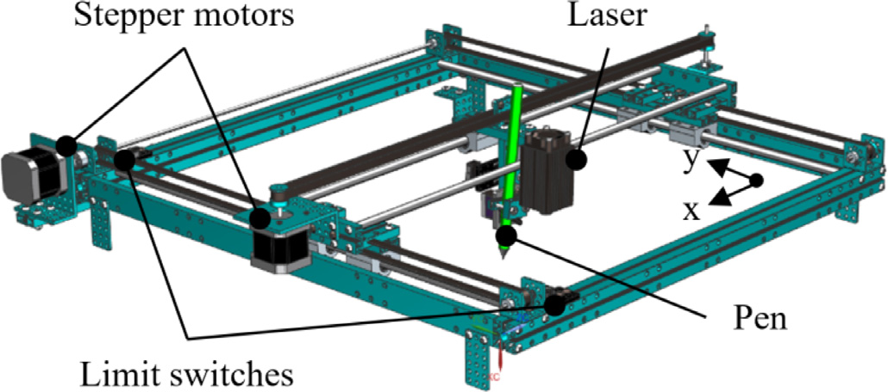
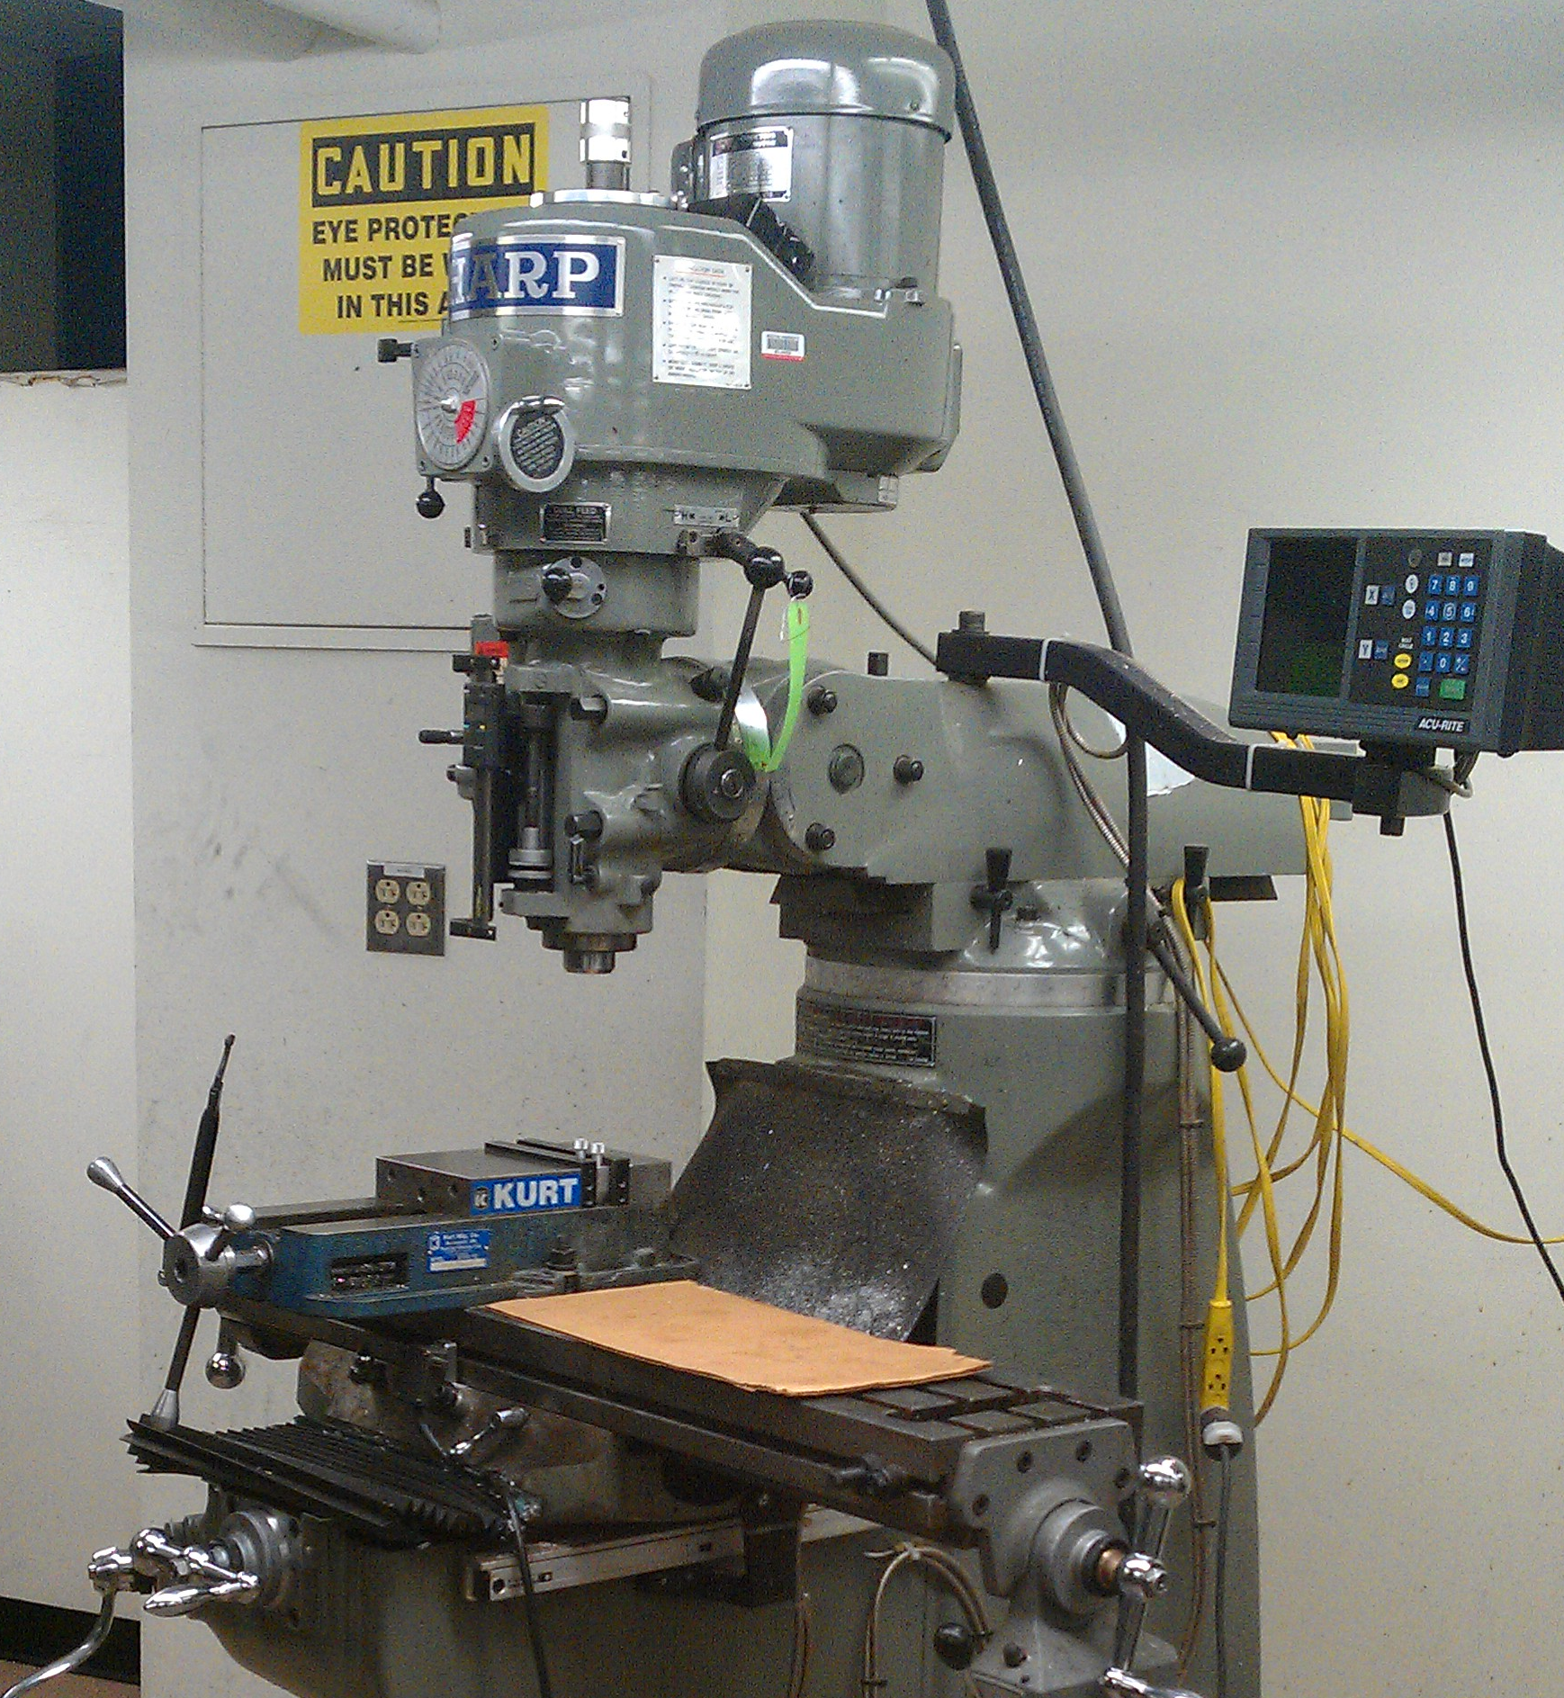
Study repurposes legacy software of a laser plotter to newer hardware and similar technologies (e.g. milling machines).
Analyse software and separate code into modules.
Use existing modules to develop software for the required hardware.
Quality assurance, first using digital twin.
Reduces financial and environmental costs of developing software.
Case Study:
‘Recycling’ Laser Plotter Software
(Kutscher et al. 2020)

Slide 47
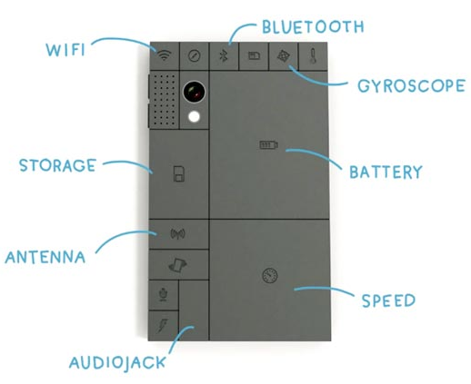
Use durable materials (although balance with ease of recyclability and safety of disposal).
Modular hardware, enabling replacement of obsolete parts rather than the whole.
Avoid unnecessary design changes between models (and makes, companies?) (Kerwin et al. 2022).
Consumer-to-consumer sales.
Companies repairing, recycling, and buying-back.
Lease rather than purchase?
Hardware

Slide 48
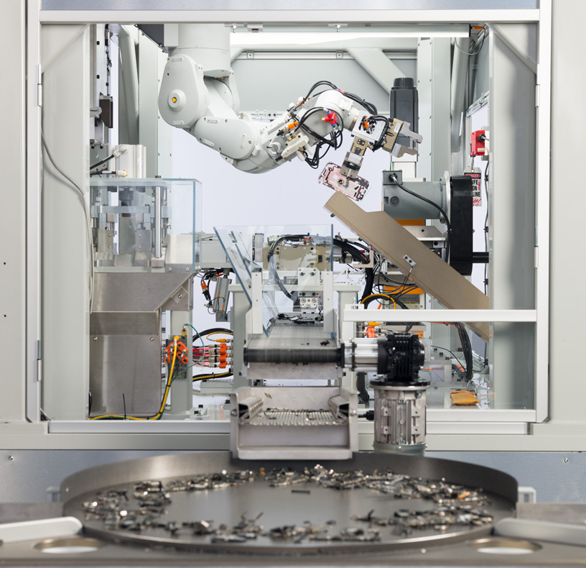
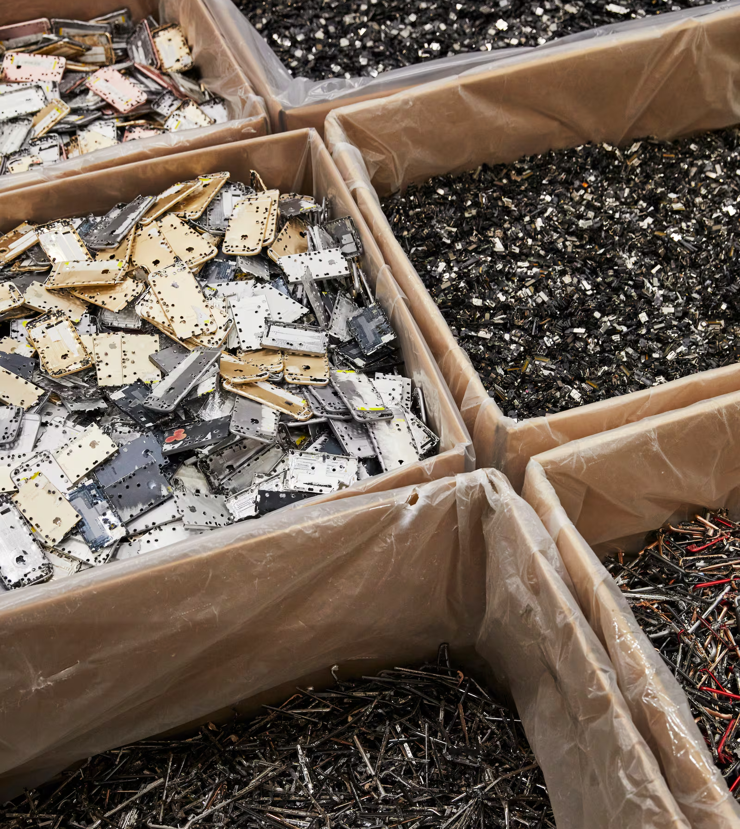
Apple’s assembly line, disassembling old iPhones for recycling at a rate of 200 per hour.
2010-2017: From last place to second place on Greenpeace’s green technology report.
iPad Air uses 100% recycle aluminium.
iPhone 13 used recycled tungsten.
Part of Apple’s pledge of net zero carbon emissions by 2030.
Case Study:
Apple’s Daisy
(O’Brien 2022)

Slide 49
Case Study: Dell
(Dell Technologies 2023)
Pledged in 2030 to reuse or recycle 1 tonne of product for every tonne sold.
Design to reduce number and size of components.
Aim for repairability and modularity.
Standardise parts, e.g. fittings.
Easy disassembly.
Aim to enable consumer or technician to repair device.
Make spare parts and manuals available.
Offer to recycle products of any quality for free.
Leasing options.

Slide 50


A study repurposing old laptops into terminals for cloud computing.
Laptops no longer fit for purpose as is, but components can be used for terminals.
Used motherboards, processes, and memory from laptops, recycling other components.
9% of surveyed laptops were suitable for repurposing.
Design changes to laptops make this easier, e.g. heatsinks instead of fans.
Case Study:
Notebooks to Terminals
(Coughlan et al. 2018)

Slide 51
Evaluating the Circular Economy

Slide 52
What are some strengths of the circular economy?
Activity 6:
Think, Pair, Share

Slide 53
Strengths (Hofmann 2019: 365-366)
Reduces waste (materials and energy).
Reduces greenhouse gas emissions.
Decouples economic growth from “natural resource consumption”, enabling increased growth without increased resource consumption.
More efficiency and lowered costs in sourcing raw materials, product development, manufacture.

Slide 54
Strengths (Hofmann 2019: 366)
Longer-term and more engaged commercial relationships between businesses and customers, and customers return to business for repairs, etc. Enables businesses to learn more about and meet customers’ needs.
Resilience: Lower dependency on natural resources, so less vulnerable to supply chain disruptions due to war, natural disasters, etc.

Slide 55
Can you think of any potential problems with the model of the circular economy?
Are there examples of objects or processes in your field for which the Circular Economy will not work? Maybe in your own field?
The following comics are taken from 360dialogues, based on the 5th Factor X publication from the Federal Environment Agency (UBA), The Impossibilities of the Circular Economy: Separating Aspirations from Reality.
Activity 7:
Think, Pair, Share

Slide 56
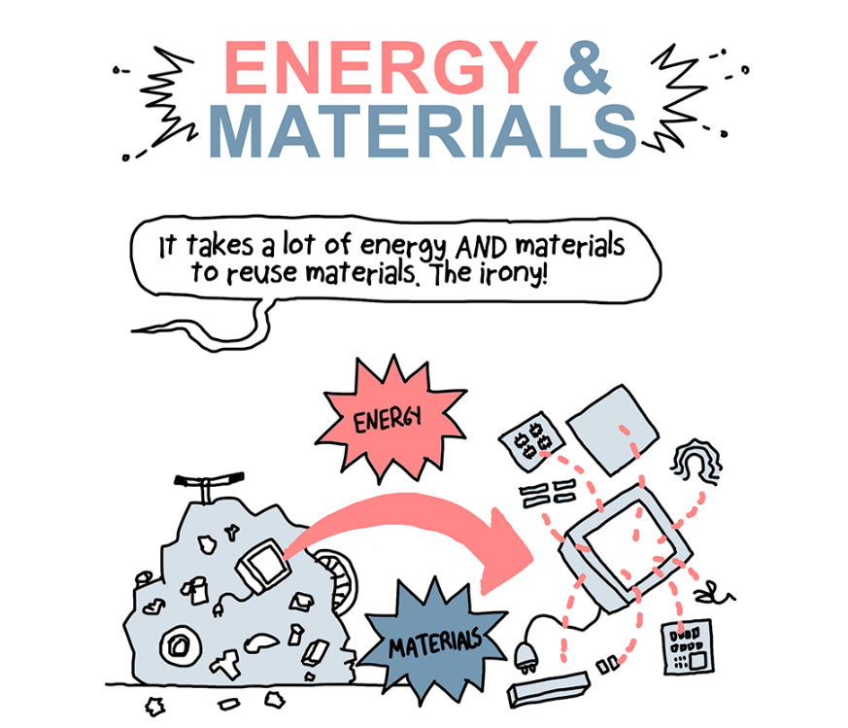
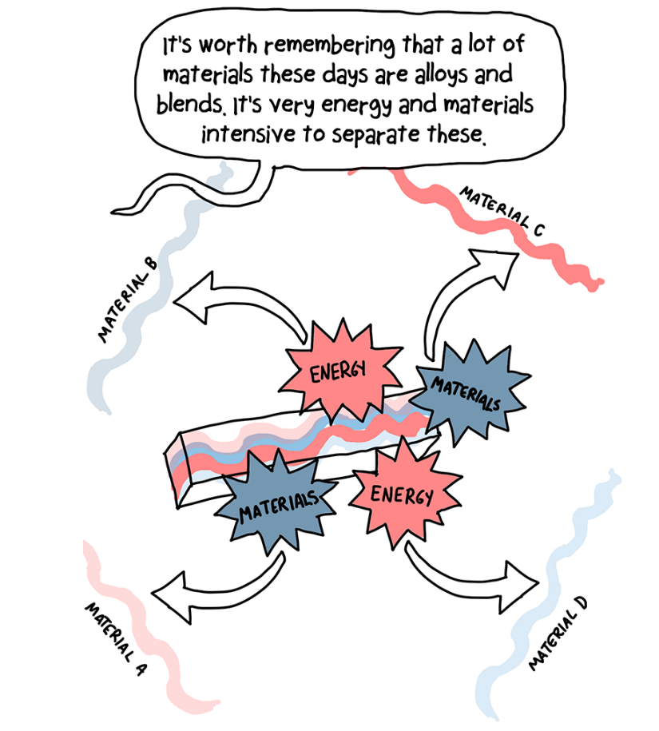
Objection 1: Energy and Materials
(360dialogues)

Slide 57
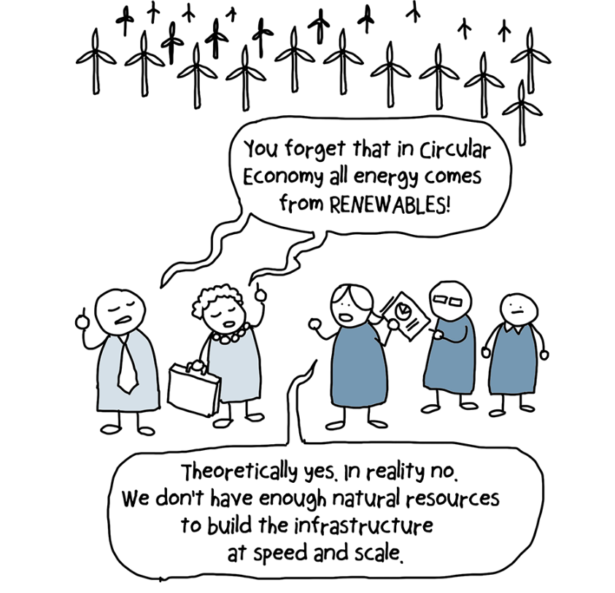
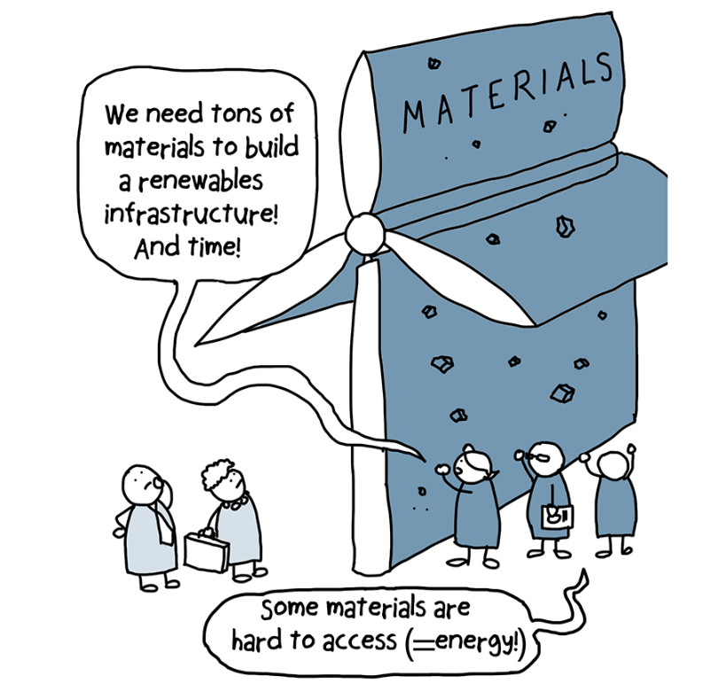
Objection 2: Renewable Infrastructure
(360dialogues)

Slide 58
Objection 3: Jevons Paradox
(Baslev et al. 2023; Korhonen et al. 2018: 42)
Increased efficiencies may not reduce material resource consumption.
Jevons Paradox, from 19thC economic William Stanley Jevons.
When efficiency increases, it costs less resource and labour to produce a product, so it becomes cheaper, so people consume more. So, overall resource and labour consumption increase.
Steam engine became more efficient, needing less coal for a single journey, so more people travelled, so more coal used overall.
Circular economy would make production more efficient, but could increase consumption, emissions, and waste if this encourages people to buy more.

Slide 59
Activity 8: Vote With Your Feet
“We should adopt a circular economy”

Slide 60
Value Conflict and Sustainability

Slide 61
Value Conflict and Sustainability
However we define it, sustainability will likely conflict with other worthy goals or will require us to pursue goals that conflict with each other.
Is reducing carbon emissions consistent with:
  Poverty reduction?
  Human welfare
  Democracy?
Also conflict between preserving natural environments/ecosystems and using this land effectively.
Constraints of finite resources/time.

Slide 62
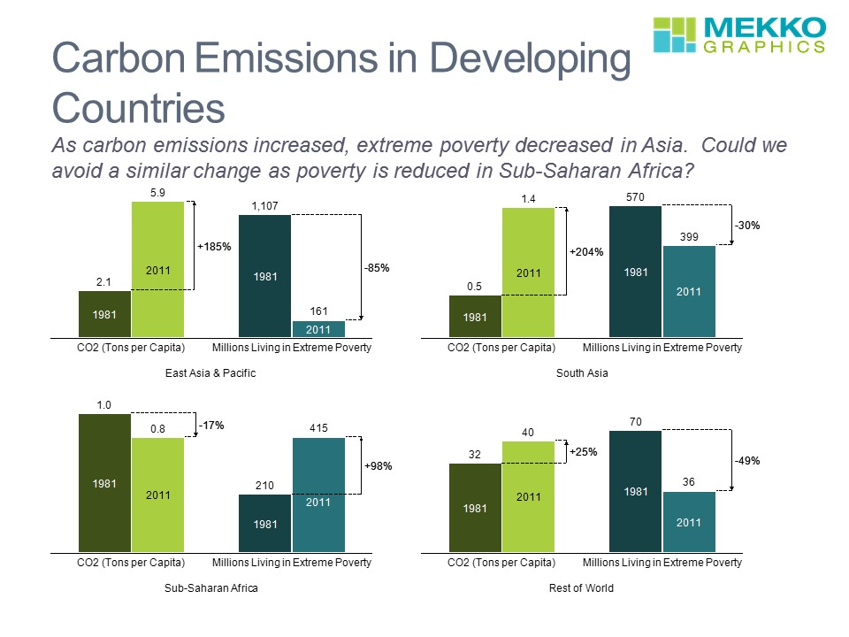
Carbon Emissions and Poverty
Carbon emissions result from processes that generate energy and enable us to produce things we need.
These processes have enabled countries to industrialise and develop.
Radically reducing carbon emissions in lower-income countries will make this more difficult for them.

Slide 63
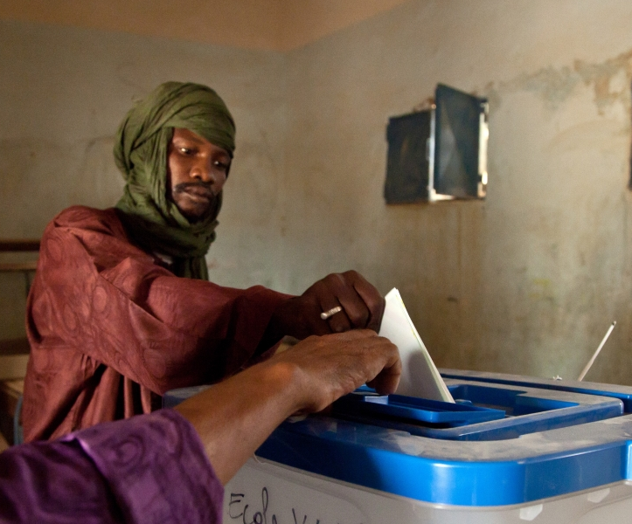
“Holding a paper ballot election for 10,000 voters generates greenhouse gas emissions of over 500kg of CO2. That’s equivalent to driving over 1000 miles in an average passenger car. The environmental cost increases if you are mailing the ballot to voters.” - Simply Voting (2021)
Democratic elections are one of the things that we value (significantly).
It would be absurd to suggest that we should abandon or reduce these to reduce our carbon emissions.
So, there is a trade-off here, and we choose against reducing carbon emissions.
Carbon Emissions and Voting

Slide 64
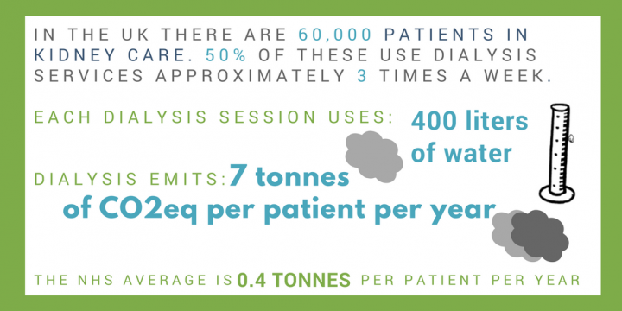
Carbon Emissions and Medical Treatment
(Centre for Sustainable Healthcare, 2021)

Slide 65
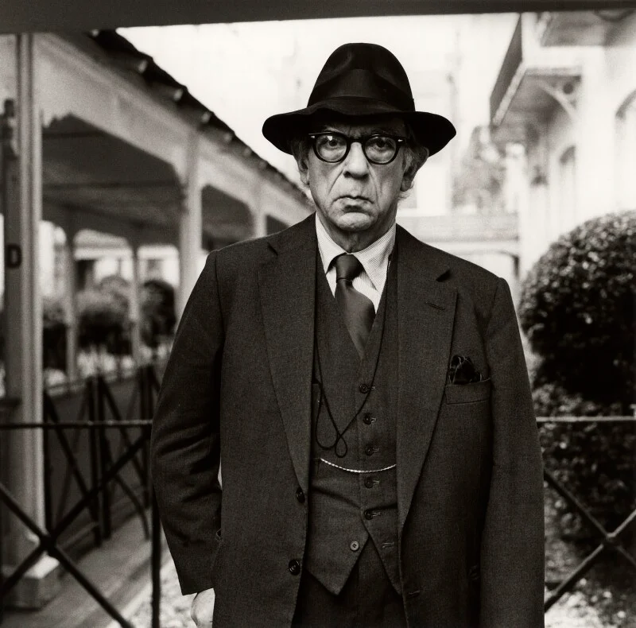
“The notion of the perfect whole, the ultimate solution in which all good things coexist, seems to me not merely unobtainable - that is a truism - but conceptually incoherent…
Some among the great goods cannot live together. That is a conceptual truth. We are doomed to choose, and every choice may entail an irreparable loss.”
Isaiah Berlin, The Proper Study of Mankind
Sometimes, we must choose between goals or values that are deeply important.
Competing Values

Slide 66
Summary
Defining Sustainability
The UN Sustainable Development Goals
Case Studies
What is the Circular Economy?

Slide 67
References
Husam Alissa, Teresa Nick, Ashish Raniwala, Alberto Arribas Herranz, Kali Frost, Ioannis Manousakis, Kari Lio, Brijesh Warrier, Vaidehi Oruganti, T. J. DiCaprio, Kathryn Oseen-Senda, Bharath Ramakrishnan, Naval Gupta, Ricardo Bianchini, Jim Kleewein, Christian Belady, Marcus Fontoura, Julie Sinistore, Mukunth Natarajan, Lauren Johnson, VeeAnder Mealing2, Praneet Arshi, and Madeline Frieze (2025), “Using life cycle assessment to drive innovation for sustainable cool clouds”, Nature 641, pp.331-338.
Jude Coleman (2023), “AI’s Climate Impact Goes beyond Its Emissions”, Scientific American. https://www.scientificamerican.com/article/ais-climate-impact-goes-beyond-its-emissions/
John Cook et. Al. (2013), Quantifying the consensus on anthropogenic global warming in the scientific literature. Environmental Research Letters, 8, 1-7.
Peter Dauvergne (2022), “Is artificial intelligence greening global supply chains? Exposing the political economy of environmental costs”, Review of International Political Economy 29(3), pp.696-718.
Dell Technologies (2023), “Circular Economy Principles”. https://www.delltechnologies.com/asset/en-nz/solutions/business-solutions/briefs-summaries/dell-technologies-circular-economy-principles.pdf
Future Platforms (2025), “What is a Digital Circular Economy?” https://www.futureplatforms.com/blog/what-is-a-digital-circular-economy
Victoria Gill (2022a), “Mine e-waste, not the Earth, say scientists”, BBC News. https://www.bbc.co.uk/news/science-environment-61350996
Victoria Gill (2022b), “E-waste: Five billion phones to be thrown away in 2022”, BBC News. https://www.bbc.co.uk/news/science-environment-63245150
Kristina Kerwin, Deborah Andrews, Beth Whitehead, Naeem Adibi, and Silvio Lavandeira (2022), “The significance of product design in the circular economy: A sustainable approach to the design of data centre equipment as demonstrated via the CEDaCI design case study”, Materials Today: Proceedings 64, pp.1283-1289.
Vladimir Kutscher, Sebastian Ruland, Patrick Müller, Nathan Wasser, Malte Lochau, Reiner Anderl, Andy Schürr, Mira Mezini, and Reiner Hähnle (2020), “Towards a Circular Economy of Industrial Software”, Procedia CIRP 90, pp.37-42.

Slide 68
References
Benjamin C. Lee, David Brooks, Arthur van Benthem, Mariam Elgamal, Udit Gupta, Gage Hills, Vincent Liu, Linh Thi Xuan Phan, Benjamin Pierce, Christopher Stewart, Emma Strubell, Gu-Yeon Wei, Adam Wierman, Yuan Yao, and Minlan Yu (2025), Patterns 6.
Marco A. Meloni (2019), “A Circular Economy for Consumer Electronics”, in G.H. Eduljee and R.M. Harrison (ed.), Electronic Waste Management, 2nd ed. Cambridge: Royal Society of Chemistry, pp.66-100.
Modestha Mensah and Aimme van Wynsberghe (Forthcoming), “Sustainable AI meets feminist African ethics), AI and Ethics. Available at: https://link.springer.com/article/10.1007/s43681-025-00705-9
Jaya Nayar (2021), “Not So “Green” Technology: The Complicated Legacy of Rare Earth Mining”, Harvard International Review. Available at: https://hir.harvard.edu/not-so-green-technology-the-complicated-legacy-of-rare-earth-mining/
Ciara O’Brienn (2022), “Meet Daisy, Apple’s recycling robot”, The Irish Times. https://www.irishtimes.com/technology/big-tech/2022/06/02/apples-recycling-robots-and-the-race-for-net-zero/
Antonio Olivo (2024), “Internet data centers are fueling drive to old power source: Coal”, Washington Post. https://www.washingtonpost.com/business/interactive/2024/data-centers-internet-power-source-coal/
Reinder Radersma (2022), “Green Coding: Reduce Your Carbon Footprint”, ERCIM News 131, pp.19-20.
Sukhbir Sandhu (2022), “Humans generate 62 million tonnes of e-waste each year. Here’s what happens when it’s recycled”, The Conversation. https://theconversation.com/humans-generate-62-million-tonnes-of-e-waste-each-year-heres-what-happens-when-its-recycled-249842
Arun Lal Srivastav, Markandeya, Naveen Patel, Mayank Pandey, Ashutosh Kumar Pandey, Ashutosh Kumar Dubey, Abhishek Kumar, Abhishek Kumar Bhardwaj, and Vinod Kumar Chaudhary (2023), “Concepts of circular economy for sustainable management of electronic wastes: challenges and management options”, Environmental Science and Pollution Research 30, pp.48654-48675.
Wenyu Wang , Yanfang Yang, Donglei Wang and Lihua Huang (2024), “Toxic Effects of Rare Earth Elements on Human Health: A Review”, Toxics 12(317).

